Slide 1


Team 63: Arbitrary Waveform Generator
Bi-Weekly Update 1 Leandro Bracho, Nick Joseph, Oscar Medrano, Robin Smithson Sponsor: Dr. John Lusher TA: Zhewen Hu
Notes:
**30 Seconds** Robin

Slide 2
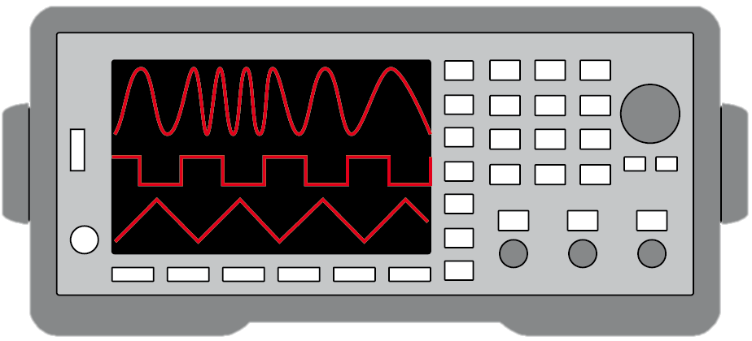
Project Summary
Problem Statement:
Test validation is a vital step in the design and fabrication of circuit boards for any project in the realm of electrical engineering.
Typical AWGs can be large and unintuitive
Solution Proposal:
Create a mobile user interface for the AWG
Bluetooth connection
Voltage range of +/- 10 V
Frequency between 1 Hz – 20 kHz
Maximum of 65,535 data points
Allow hand drawn waveforms
Notes:
**30 Seconds** TBD
Robin

Slide 3
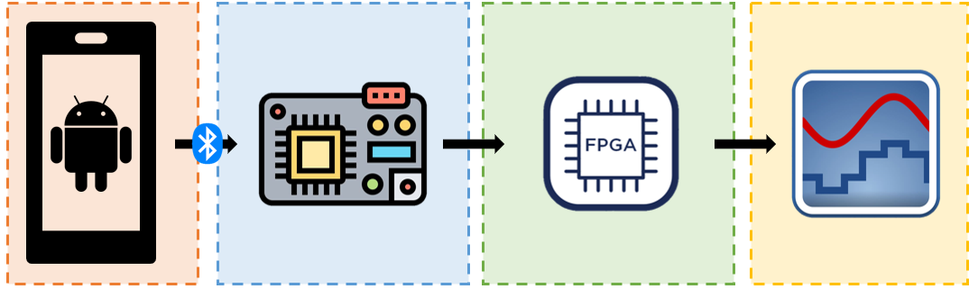
Project/Subsystem Overview
Leandro Bracho | Robin Smithson | Nick Joseph | Oscar Medrano
Android Application | Microcontroller | FPGA | DAC
Notes:
**45 SECONDS**
Robin
Diagram showing subsystems – with labels showing subsystem owners
Bullets giving essential system/subsystem characteristics
If major changes in subsystems, show before and after … see next slide

Slide 4
Major Project Changes for 404
Need to direct attention to the power system of the project so that everything can be powered through an AC adapter.
3D print case for integrated PCBs
Using Arduino for Bluetooth Connection on the MCU
Notes:
**45 SECONDS**
Leandro
Bullets on changes due to team membership changes – describe how subsystem assignments, roles, project will change to accommodate team changes
Bullets on MAJOR changes in project direction due to learning from 403. If stuff didn’t work out now is the time to redirect
-- Eg custom to COTS, MCU changes, application change, major change in communication technology,

Slide 5
Project Timeline
End of 403
- Working subsystems
January
-Revalidate Subsystems
-Update PCB Designs
-Bluetooth pairing
February
- Integrate Subsystems
March
- Debug and Test AWG
- Design and Print 3D Housing
April
- Final System and App Adjustments
- Engineering Showcase
Notes:
**30 SECONDS**
Leandro
High level figure showing where you are at in the project, what’s completed, what’s underway – it should take about 30 seconds to summarize where you are in the timeline
Save discussion for subsystem update
Save detail for execution plan & validation plan status

Slide 6
Android Application Subsystem
Leandro Bracho
Accomplishments since 403 6 hrs of effort | Ongoing progress/problems and plans until the next presentation
Three navigable screens Four Predefined Wave Functions Freehand Wave On Device Data Export Scan for BLE devices Validated Application Use | Detecting the MCU in app Add ability to pair with BLE devices
Notes:
**45 SECONDS**
Leandro:
Progress made leading into 403.

Slide 7
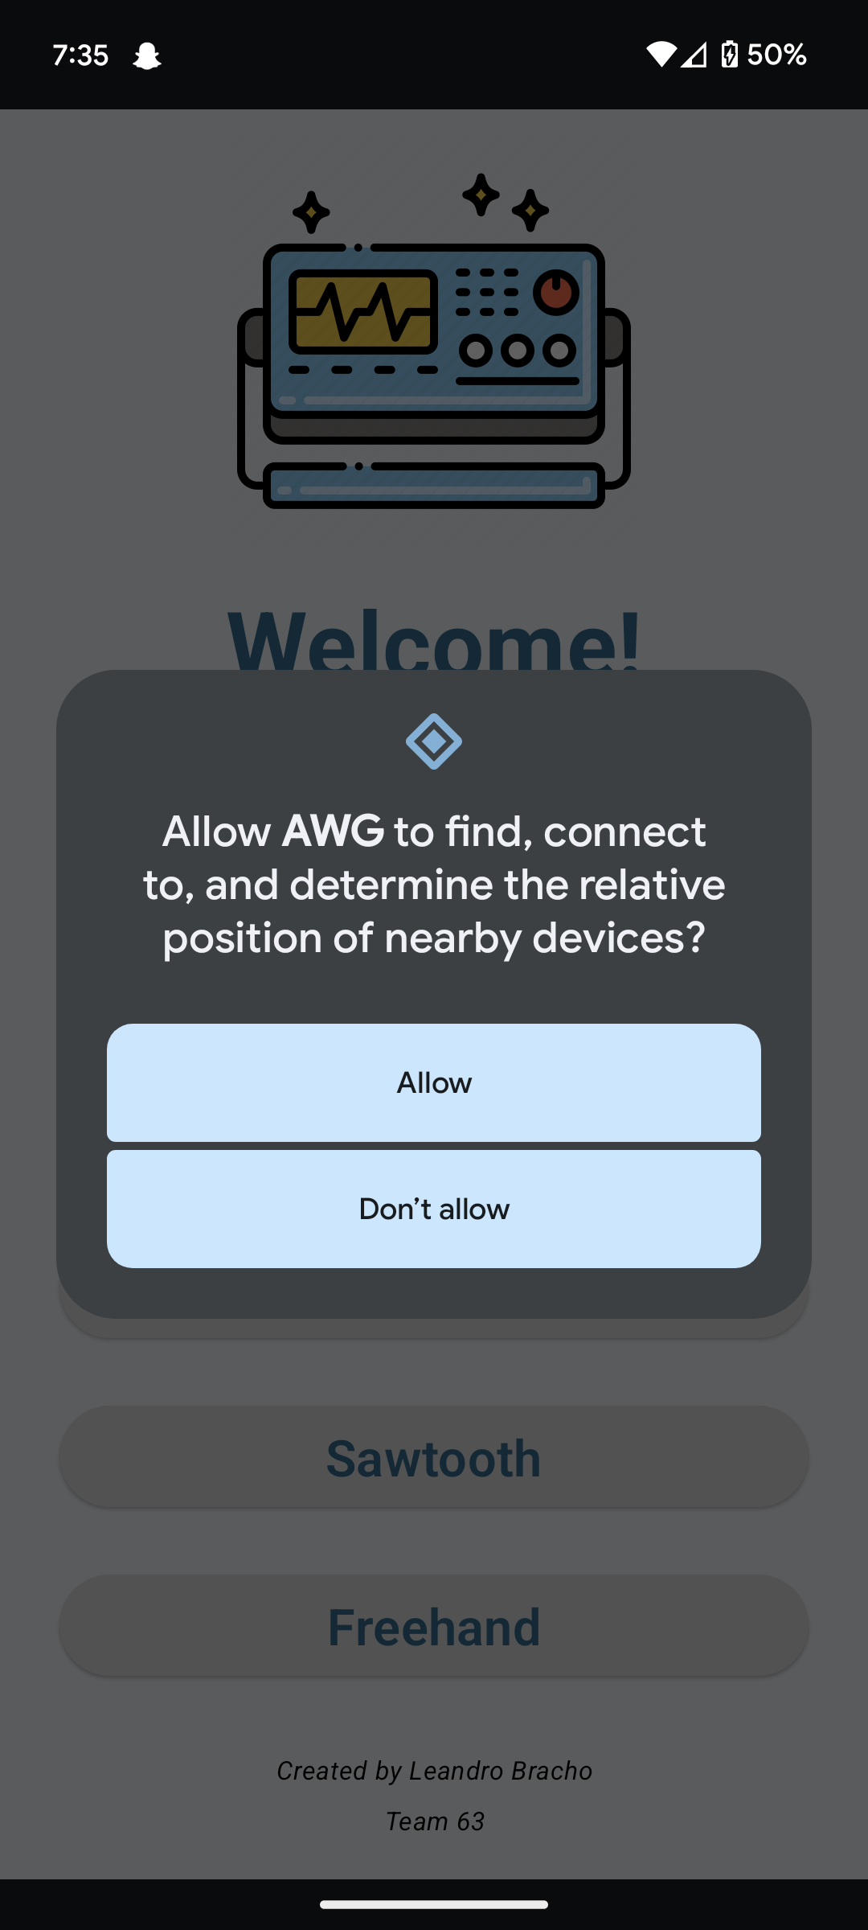
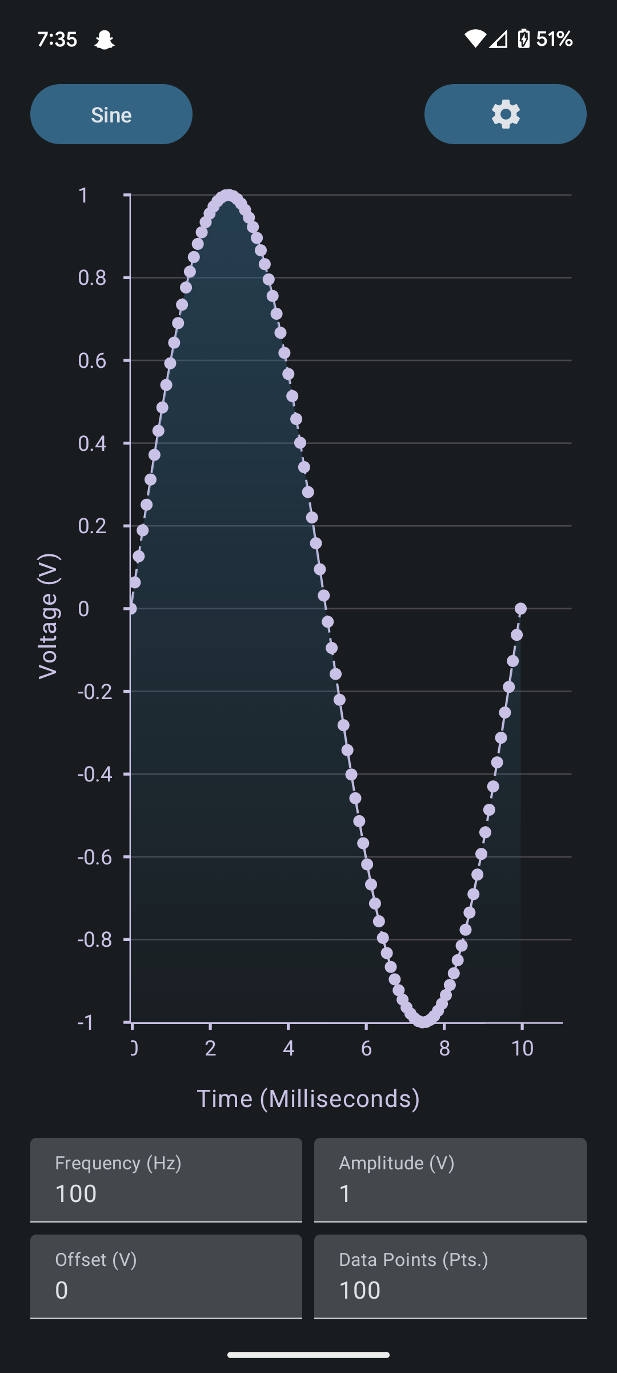
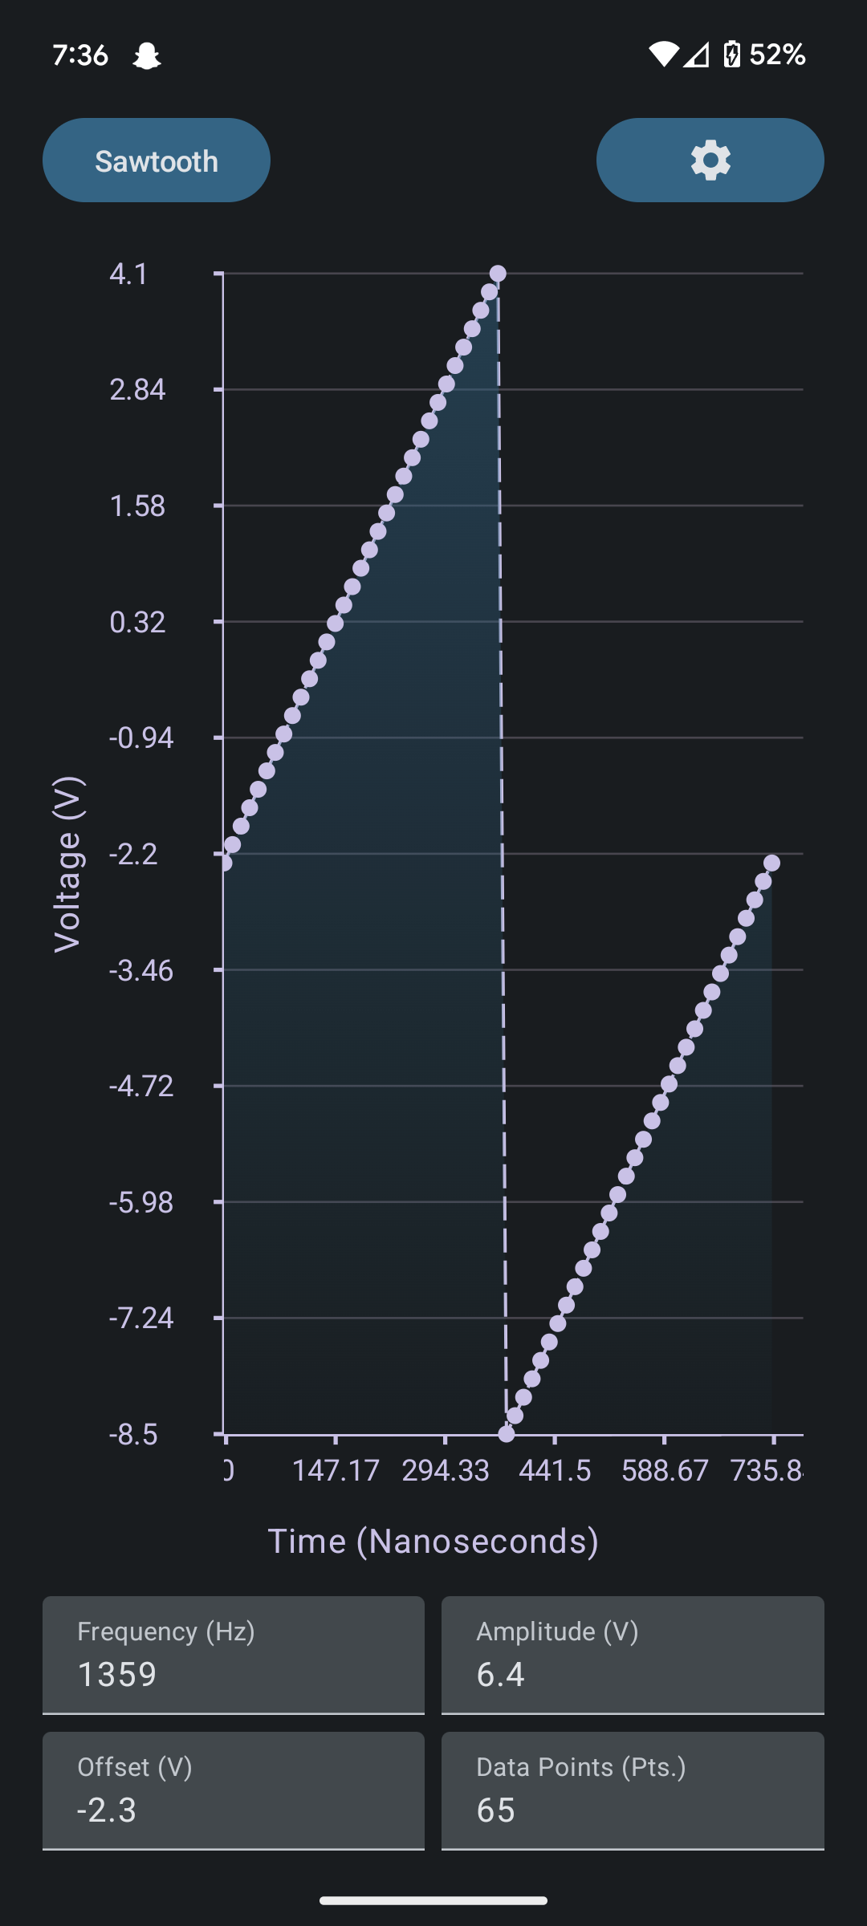
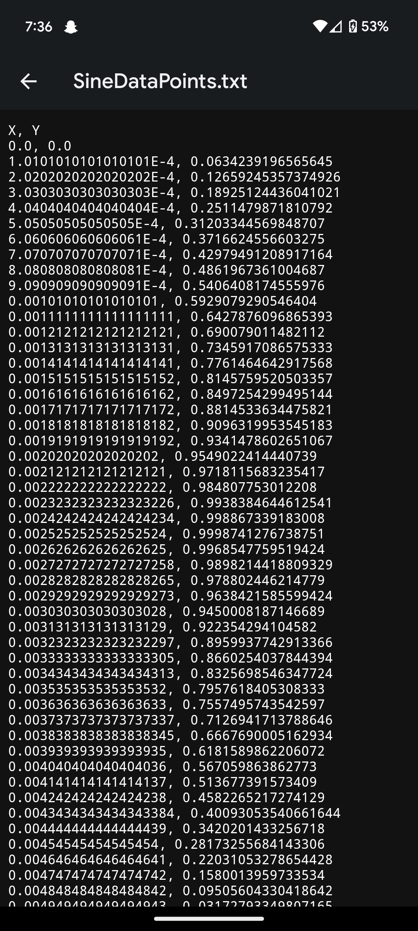
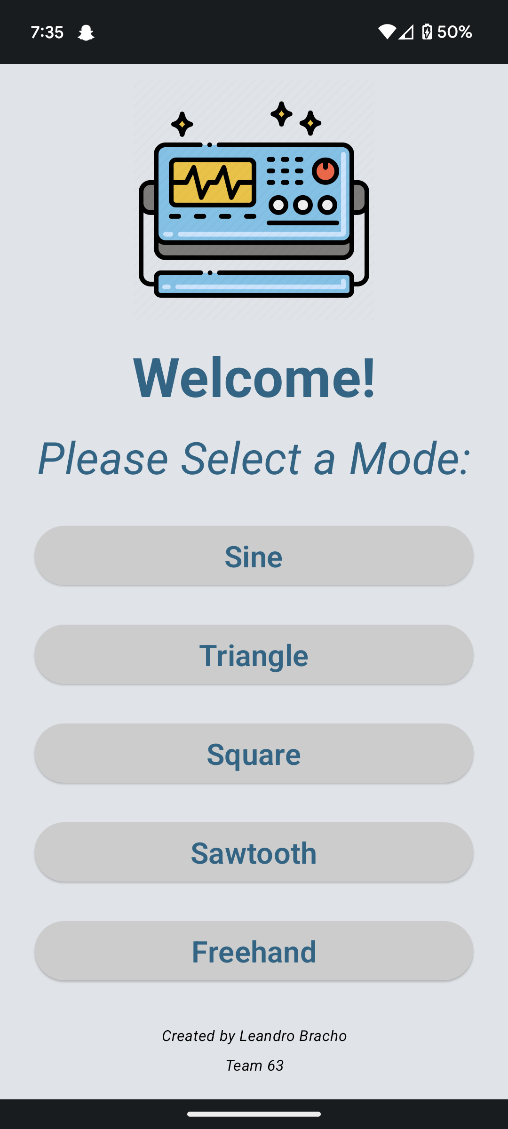
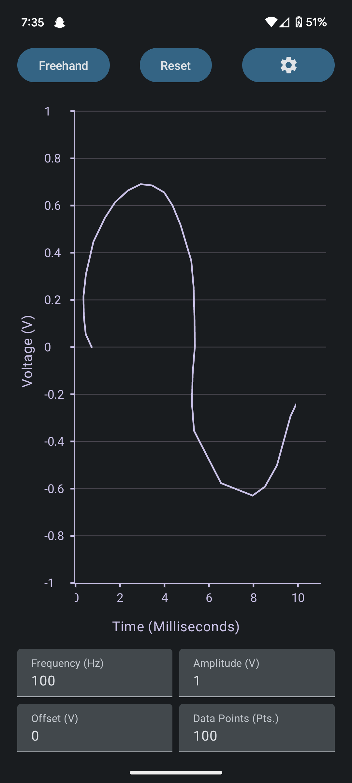
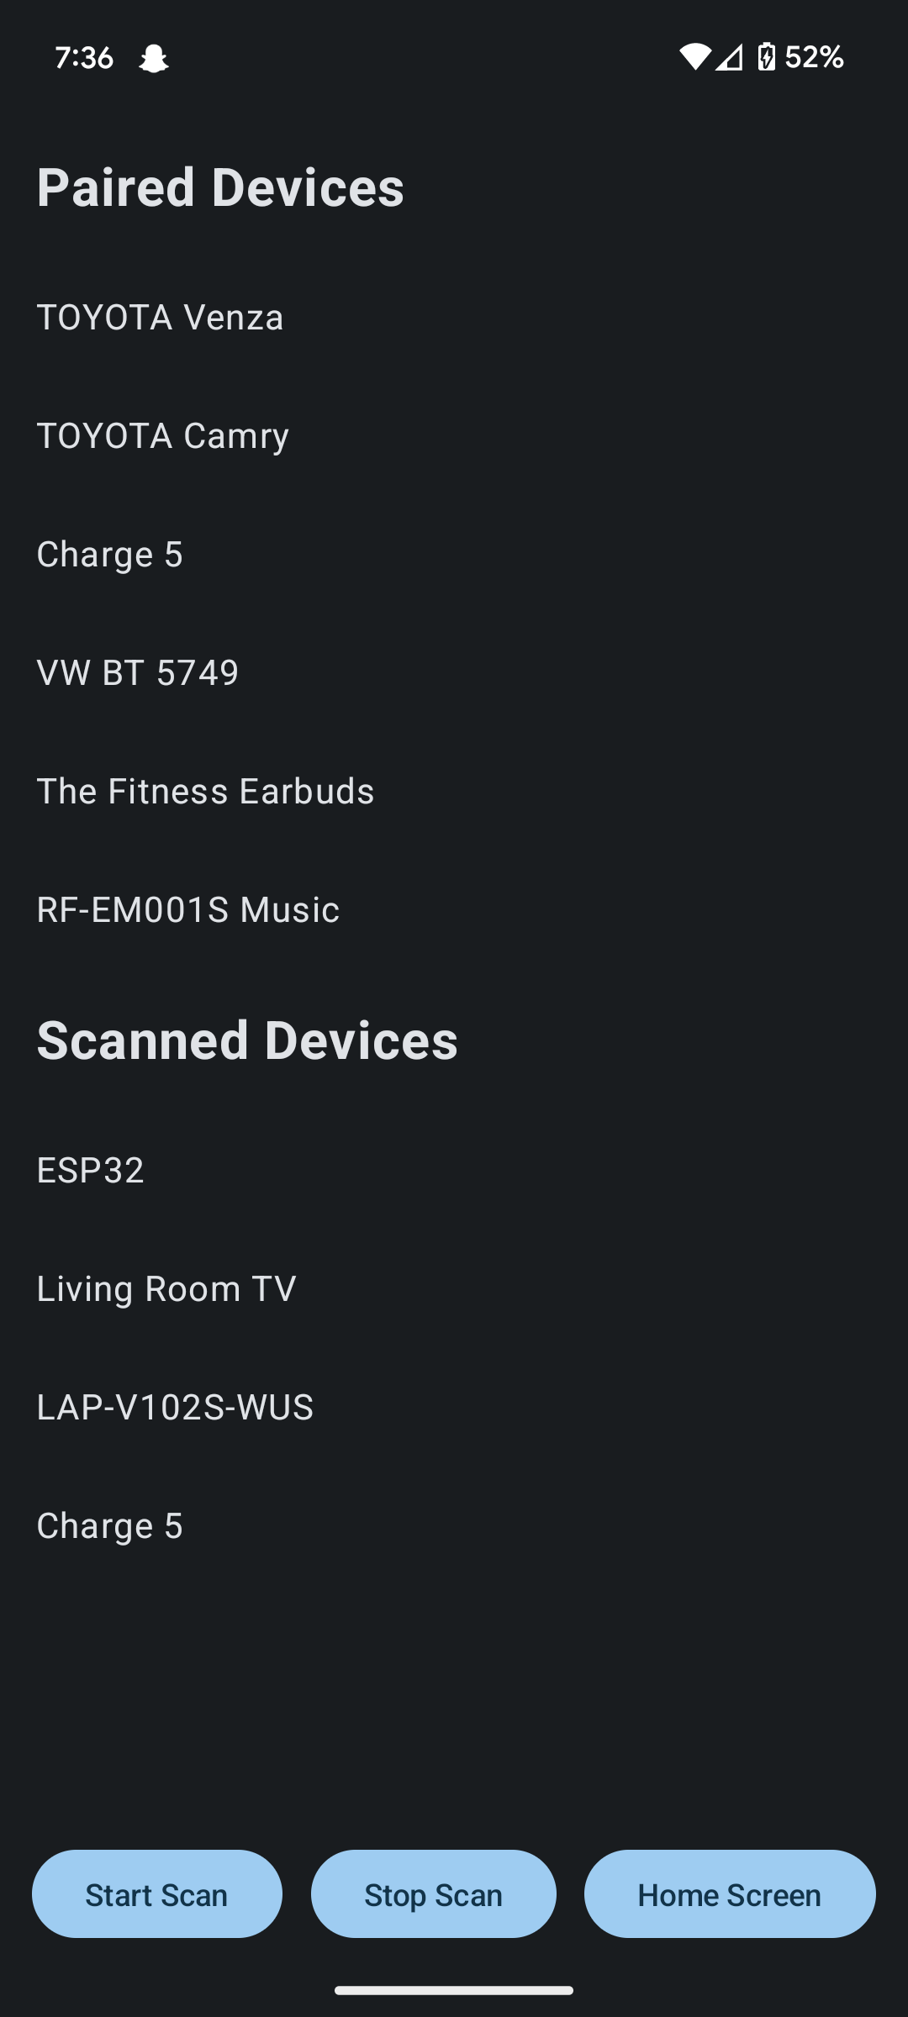
Android Application Subsystem 1
Leandro Bracho
Bluetooth Permissions
Landing Page
Sample Wave Graphs
Bluetooth Screen
Exported Data
Notes:
**45 SECONDS** Leandro,

Slide 8
Microcontroller Subsystem
Robin Smithson
Accomplishments since 403 21 hrs of effort | Ongoing progress/problems and plans until the next presentation
PCB built and running 3.3 volts 1 amp max Can receive and transmit information (internally) Switches fixed Bluetooth connection uploaded | Test Bluetooth connection Integrate power system Prepare/fine-tune receive and transmit for more data
Notes:
45 SECONDS
Robin

Slide 9
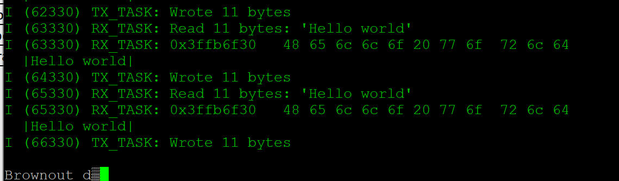
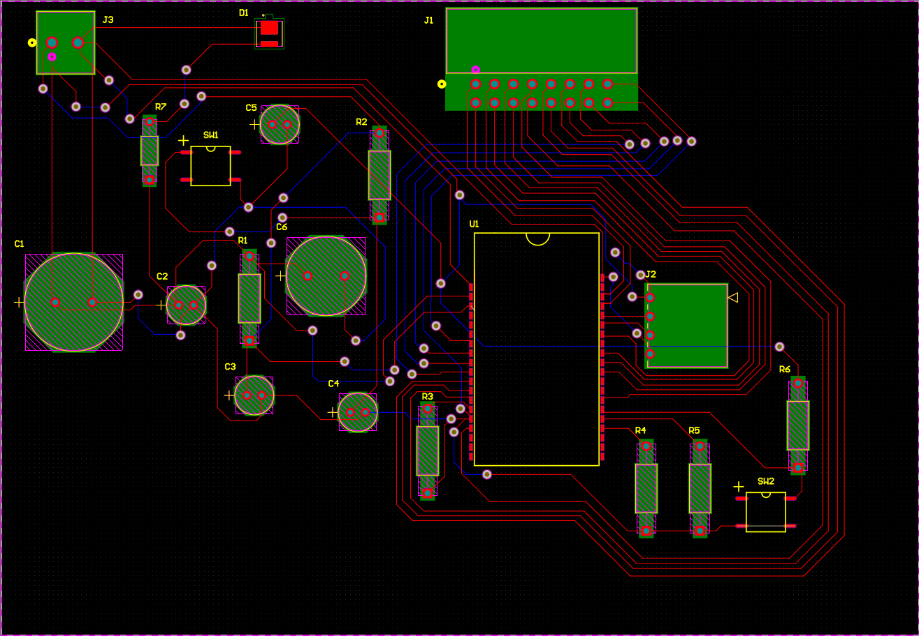
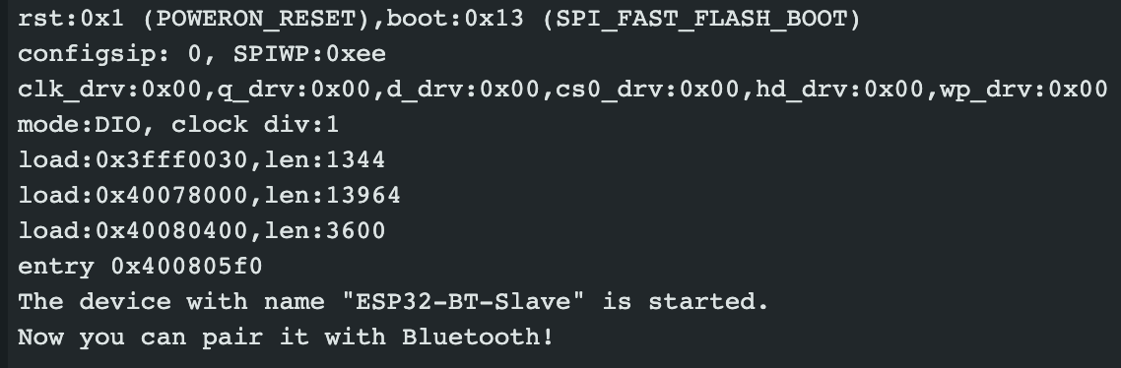
Microcontroller Robin Smithson
Notes:
45 seconds
What works:
Powers on
Internally receives and transmits data
Need to make sure it can receive and transmit 65,000+ data points
Doesn’t work:
Need to get Bluetooth up and running
Changes:
Need to replace component and wiring for switches

Slide 10
FPGA subsystem
Nick Joseph
Accomplishments since 403 10 hrs of effort | Ongoing progress/problems and plans until the next presentation
Not Back up and running Decent board redesign needed The FPGA schematic | Recheck the power connection to the FPGA Look into decoupling capacitors from the FPGA Redesign the connection with Oscar Designing the coding for the FPGA

Slide 11
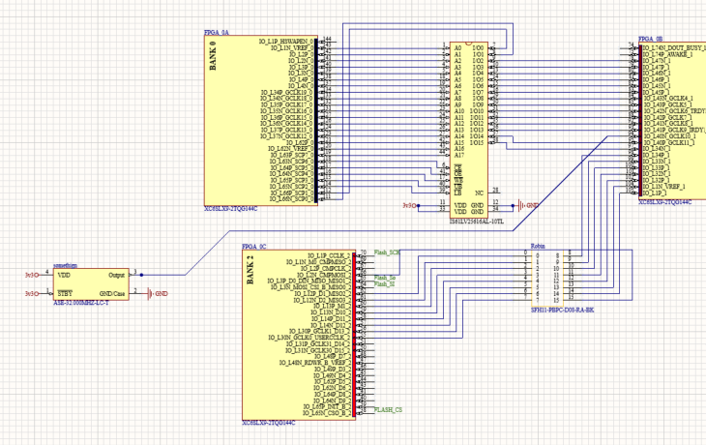
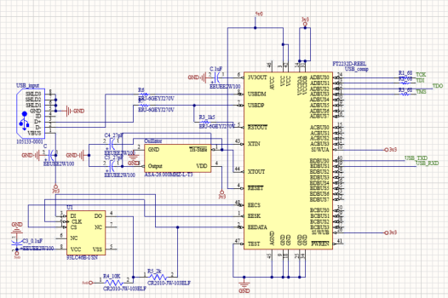
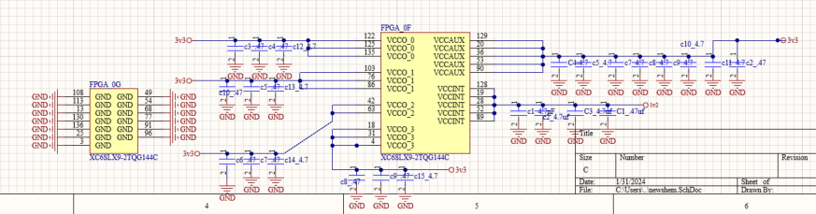
FPGA subsystem
Nick Joseph

Slide 12
DAC Circuitry & Power System
Oscar Medrano
Accomplishments since 403 8 hrs of effort | Ongoing progress/problems and plans until the next presentation
Still functioning +/- 10V output range Adopted the power system for the project. Found the ICs that will make up the power system. | Designing new schematic for dual-channel function. Need right-angle BCN connectors. Need IDC cables and connectors for integration. Creating symbols and footprints for DC-DC converters needed.

Slide 13
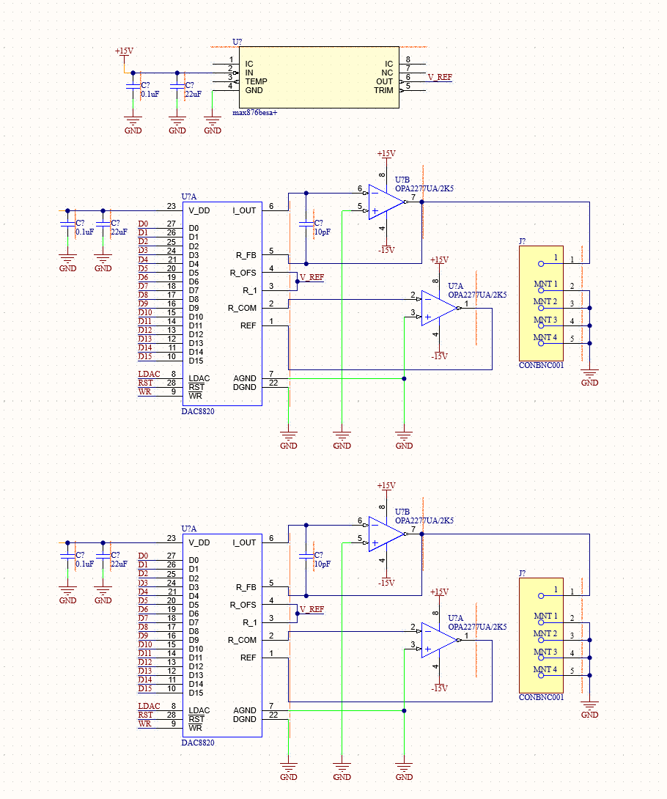
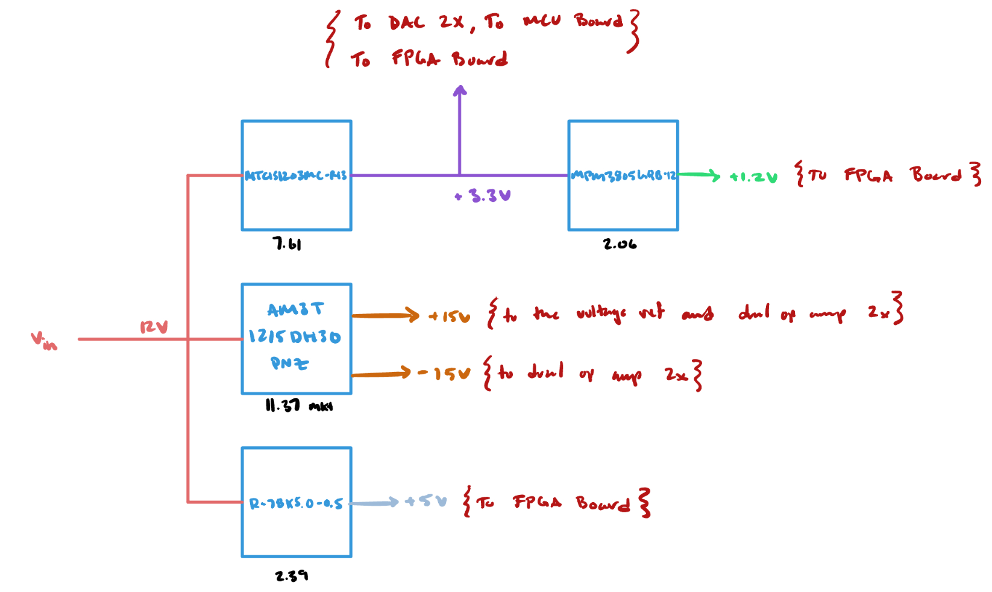
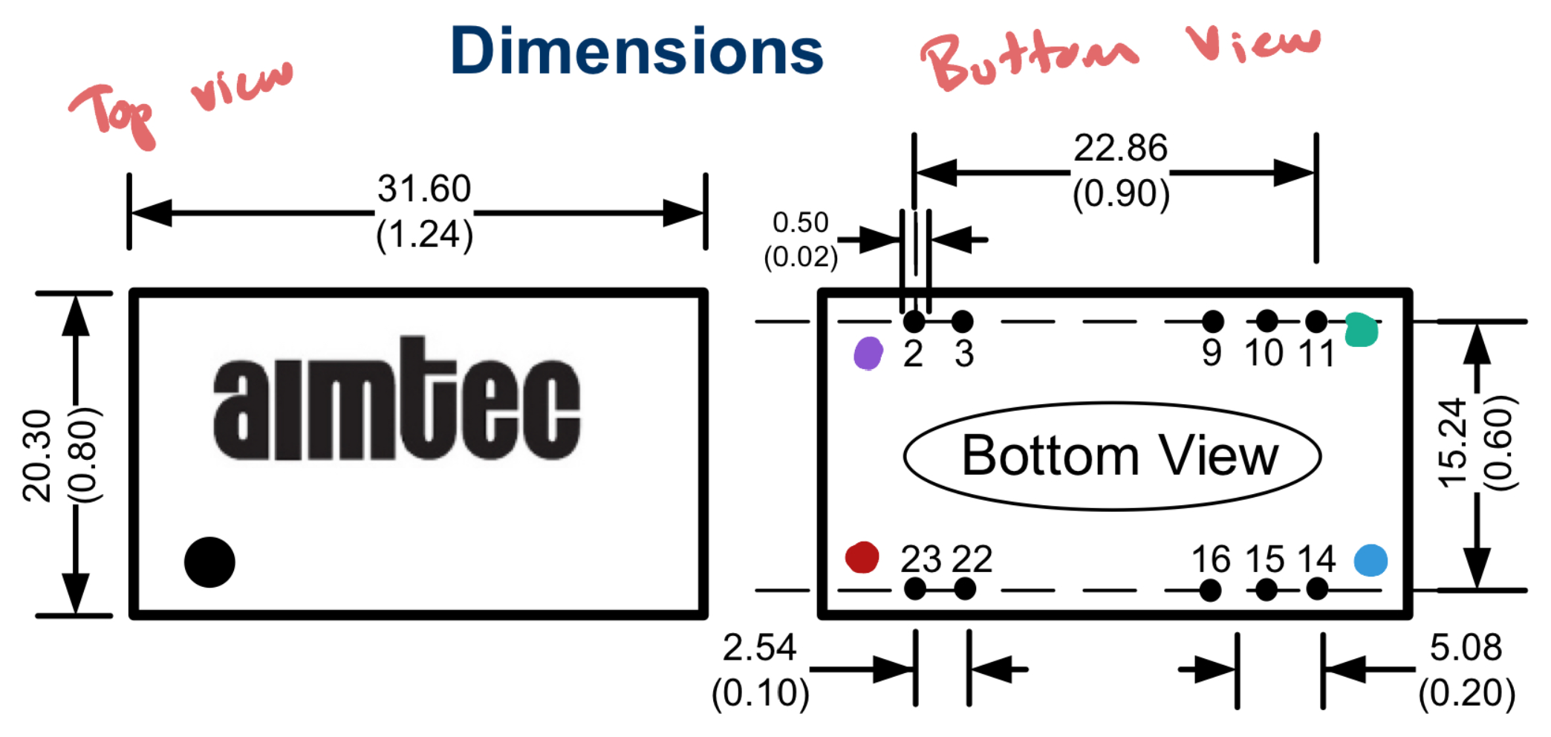
DAC Circuitry & Power System
Oscar Medrano

Slide 14
Parts Ordering Status
3 new PCBs (MCU, FPGA, DAC)
Power adapter
DC-DC Converter
IDC cables
Notes:
** 30 SECONDS **
Oscar
Most parts orders for 404 should be placed very soon.
Provide summary of what is ordered but not received and what remains to be ordered.
When do you expect to have all parts?

Slide 15
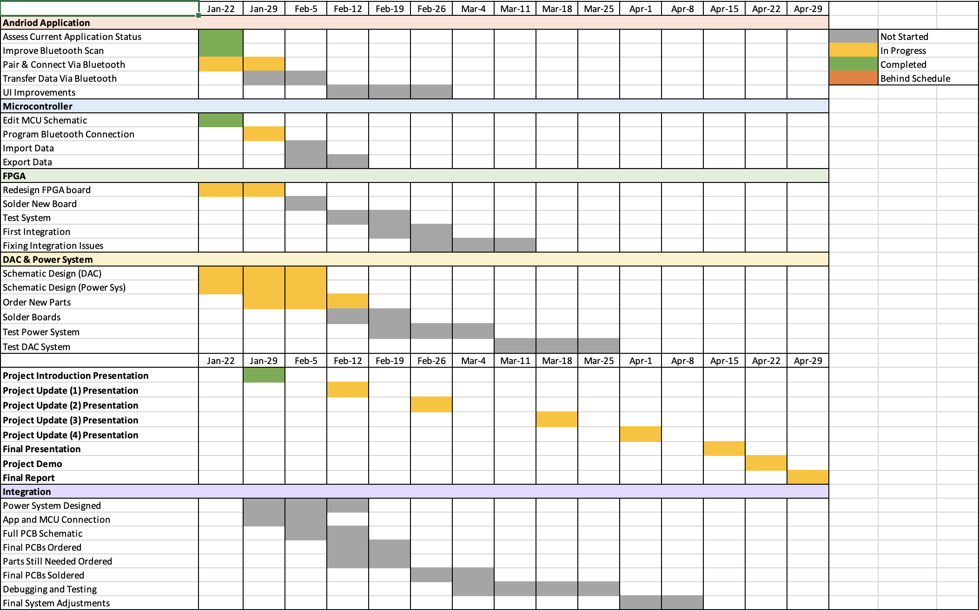
Execution Plan
Notes:
Michelle

Slide 16
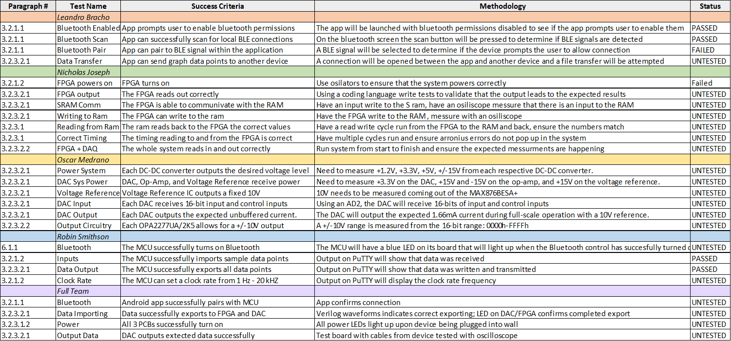
Validation Plan
Notes:
Michelle

Slide 17
Thank you

